Slide 1
IaC - CI/CD pipeline - monitoring solution
Tools: Git, Jenkins, Docker, Terraform, ansible, kubernetes, elk, Prometheus, grafana

Slide 2

Objective
Provision a kubernetes cluster
Build a CI/CD pipeline that will deploy a flask application to a kubernetes cluster
Monitor the infrastructure using ELK
My objective: Implement the solution locally and in a cloud solution, If possible

Slide 3
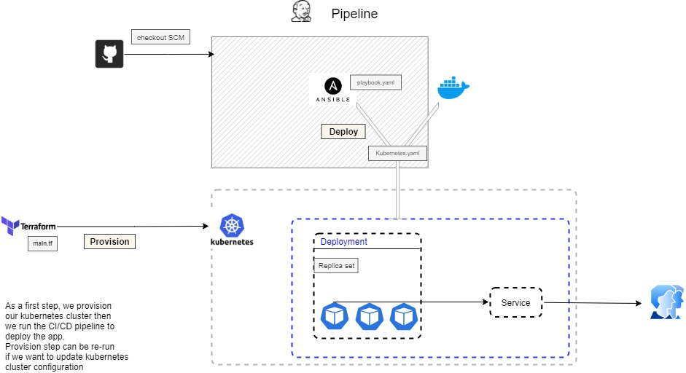
IaC & CI/CD pipeline diagram

Slide 4
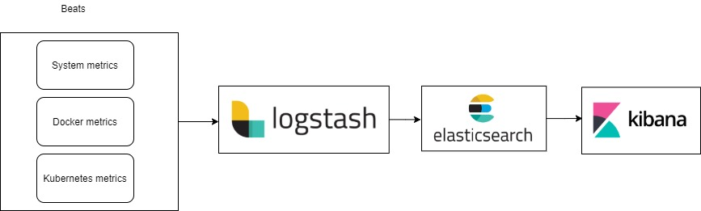
Initial monitoring solution
Use ELK stack to monitor our infrastructure.
I will be setting 3 metrics :
System metrics to monitor the host machine resources
Docker metrics to monitor Docker containers
Kubernetes metrics to monitor the Kubernetes cluster

Slide 5
Environment setup
VM with Ubuntu 20.04 with the following software already installed:
Jenkins
Ansible
Terraform
Docker
Docker-compose

Slide 6
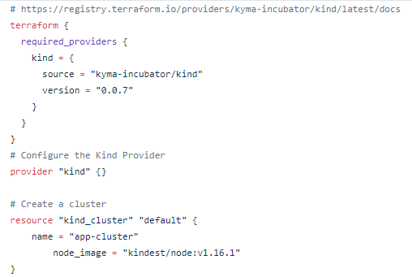
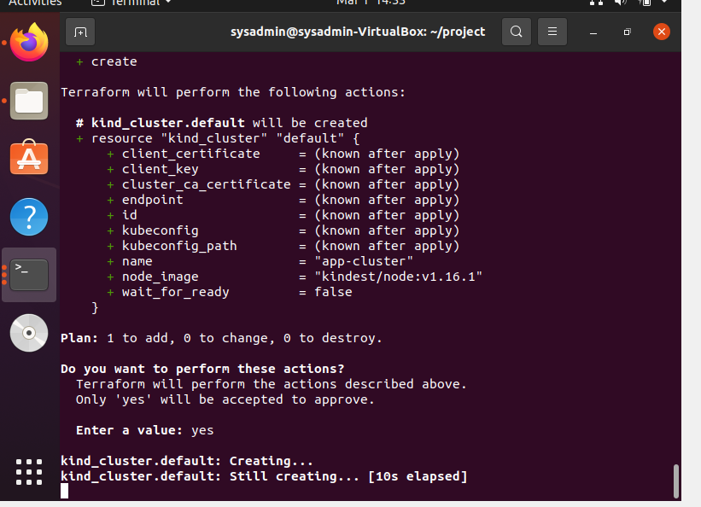
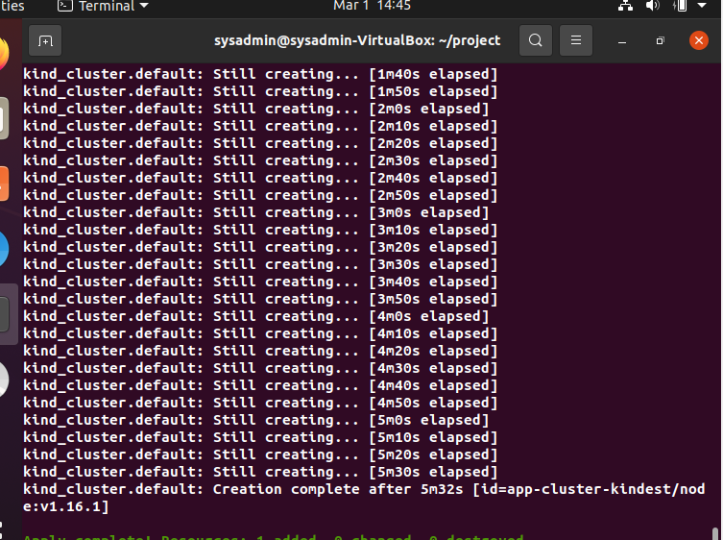
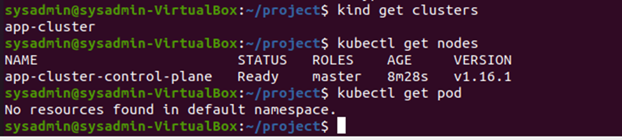
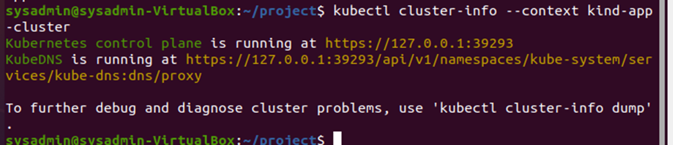
Kubernetes cluster provision
Use terraform to provision a kind (Kubernetes IN Docker) cluster
main.tf

Slide 7
Image build and deployment
Build a Jenkins pipeline that will :
Checkout Git repository
Deploy the app to kubernetes by running an ansible playbook (playbook.yaml) that will apply a kubernetes.yaml.
Kubernetes.yaml will deploy 3 replicas of the flask app ( image pulled from Dockerhub) to a kubernetes cluster and run a service
To ensure a continuous integration, I set a git scm polling to run each 1h and trigger a build

Slide 8
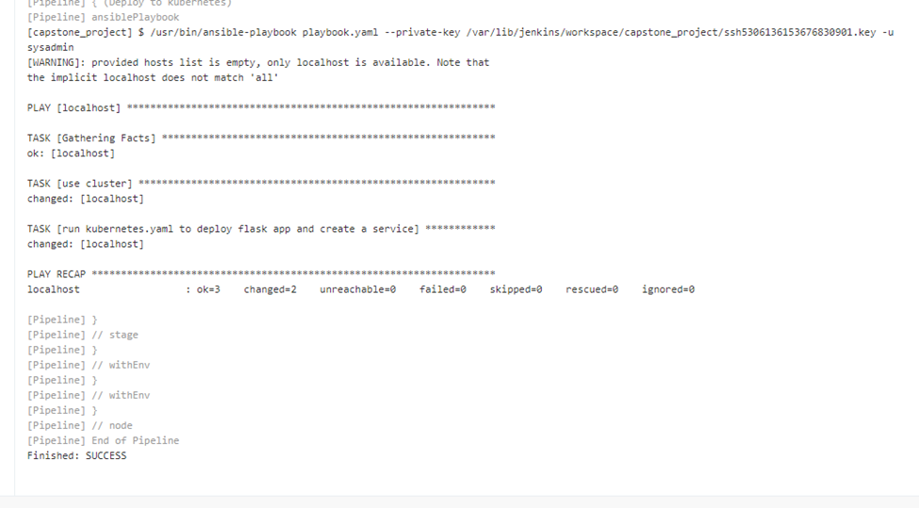
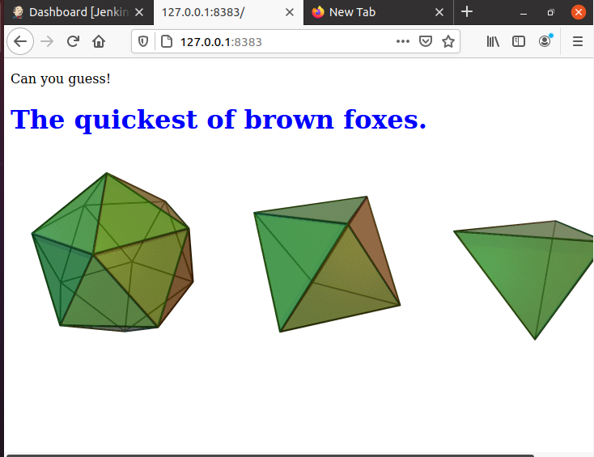
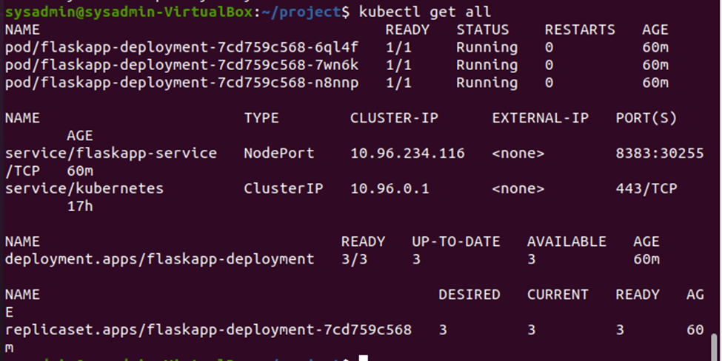
Successful deployment from Jenkins pipeline

Slide 9
Monitoring
Monitoring aims to automatically identify performance and availability problems across the infrastructure before productivity is compromised. In such situation proactive corrective actions should be implemented
We usually monitor:
Hardware – Physical Health
Network – Bandwidth consumption and errors
Application – Performance and availability
Virtualization: misallocation of virtual resources

Slide 10
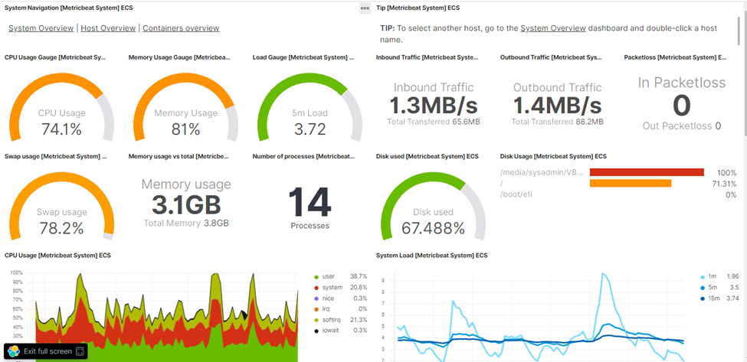
Host machine resources monitoring using ELK

Slide 11
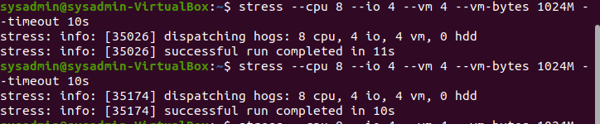
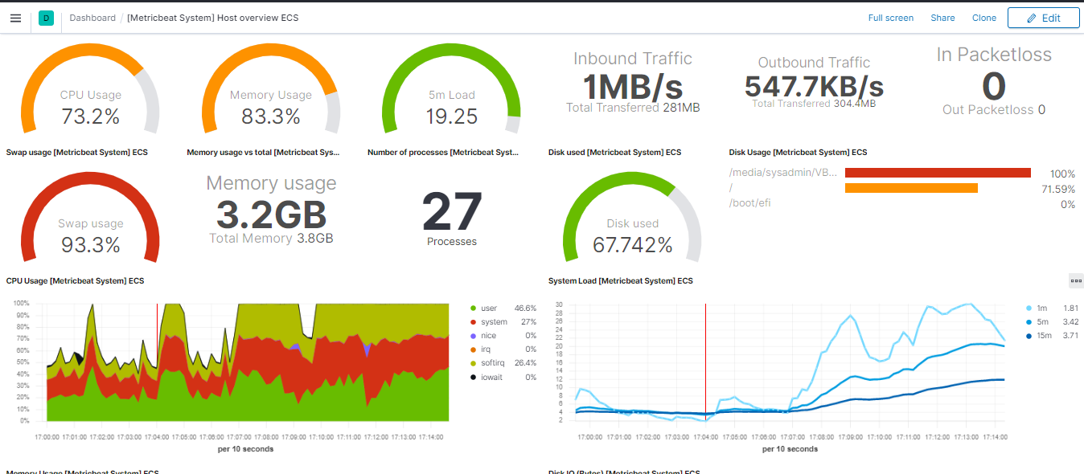
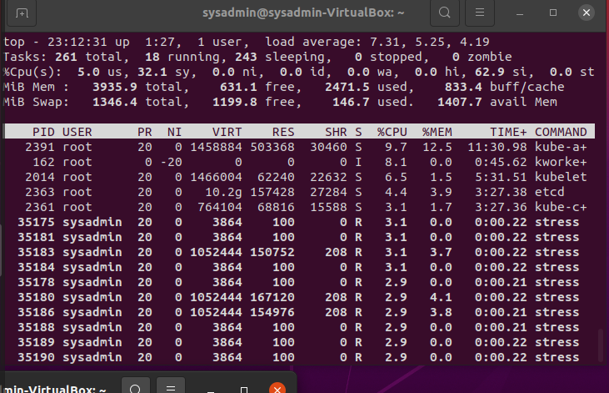
Host machine resources monitoring using ELK
Stressing my machine

Slide 12
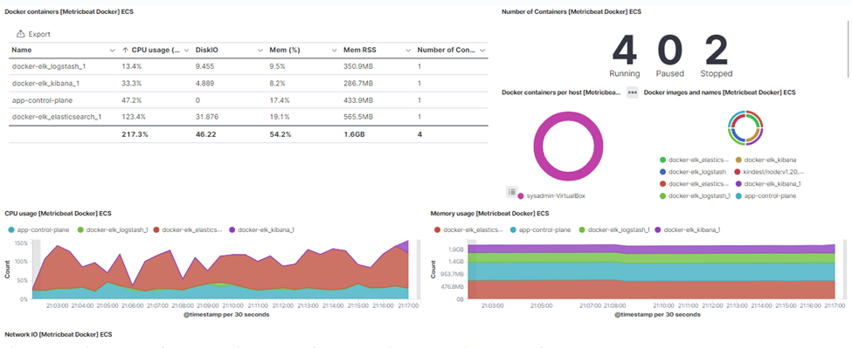
ELK Docker containers using ELK
It’s important to keep an eye on resources usage of our ELK solutions to ensure a continuous availability of a monitoring system and data

Slide 13
Kubernetes cluster monitoring
Best practices for monitoring the health and capacity of any Kubernetes environment is :
Track cluster resource usage
Monitor node resource consumption
Monitor for missing pods
Find pods that aren’t running
Troubleshoot container restarts
Track container resource usage
Monitor storage volumes
Monitor the control plane: etcd, the API server, the scheduler, and the controller manager

Slide 14
Kubernetes cluster using kube-prometheus
I didn’t succeed to setup Kubernetes monitoring via ELK stack
As a workaround , I used kube Prometheus Grafana

Slide 15
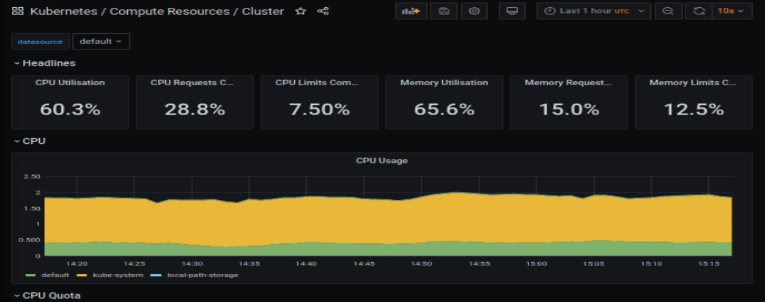
Cluster resources

Slide 16
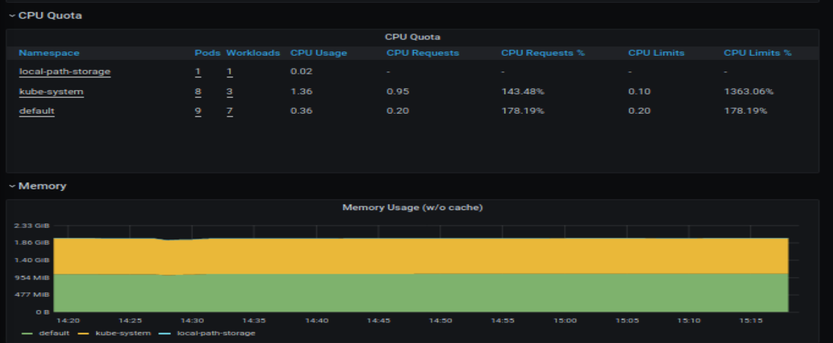
Cluster resources

Slide 17
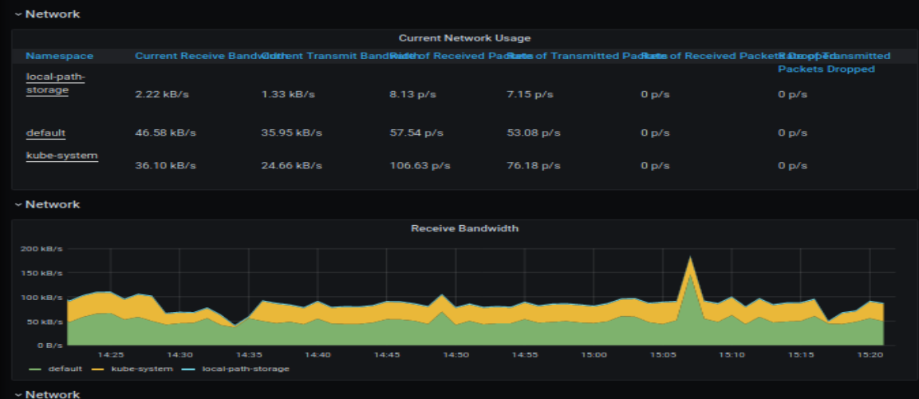
Cluster resources

Slide 18
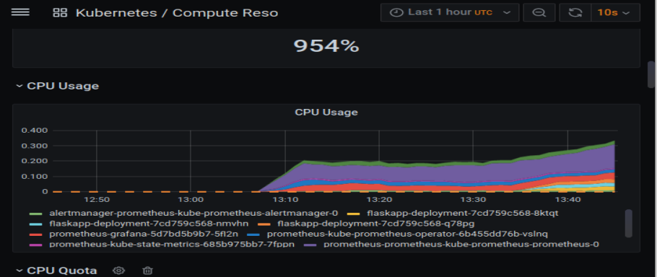
Kubernetes cluster monitoring using kube-prometheus
Pods resources

Slide 19
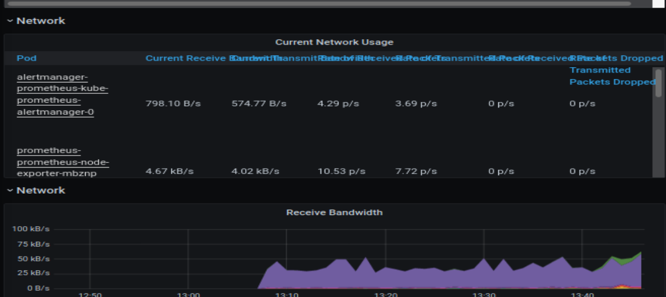
Kubernetes cluster using kube-prometheus
Pods resources

Slide 20
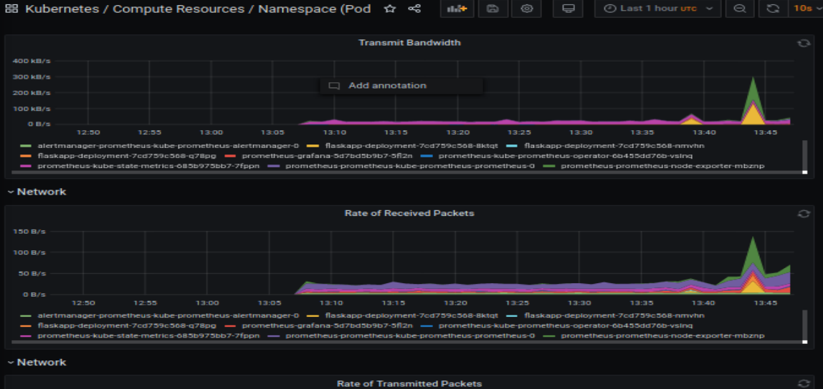
Kubernetes cluster using kube-prometheus
Pods resources

Slide 21
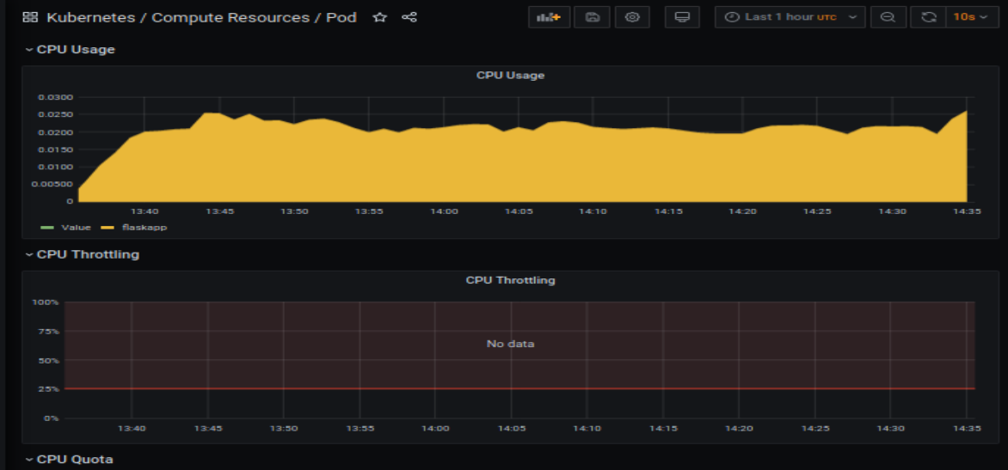
Kubernetes cluster using kube-prometheus
Flask app monitoring

Slide 22
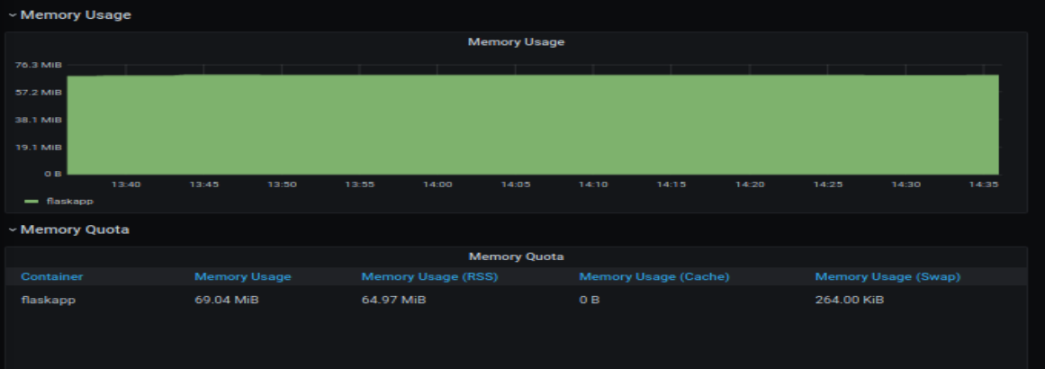
Kubernetes cluster using kube-prometheus
Flask app monitoring

Slide 23
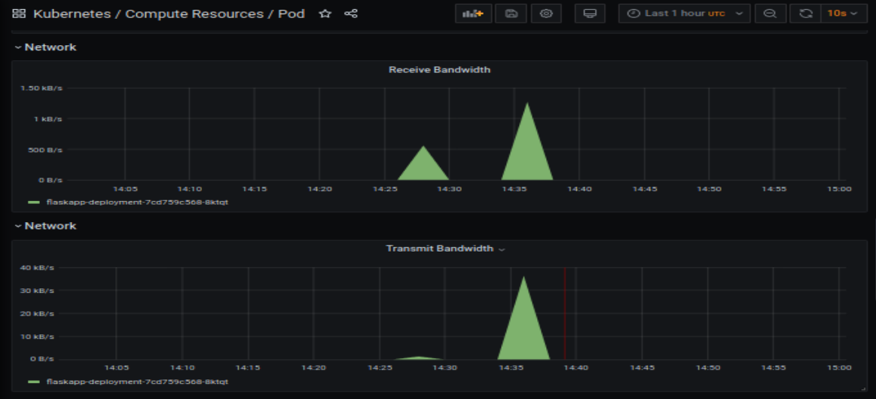
Kubernetes cluster using kube-prometheus
Flask app monitoring

Slide 24
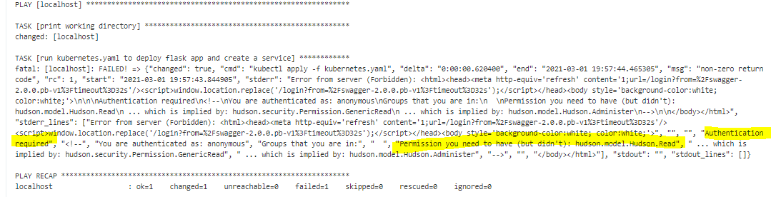
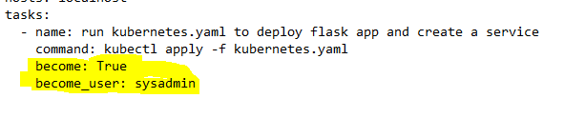
Challenges:
I was receiving a permission error issue when jenkins runs the kubernetes.yaml from the ansible playbook .
Fixed by adding the user with SSH rights

Slide 25
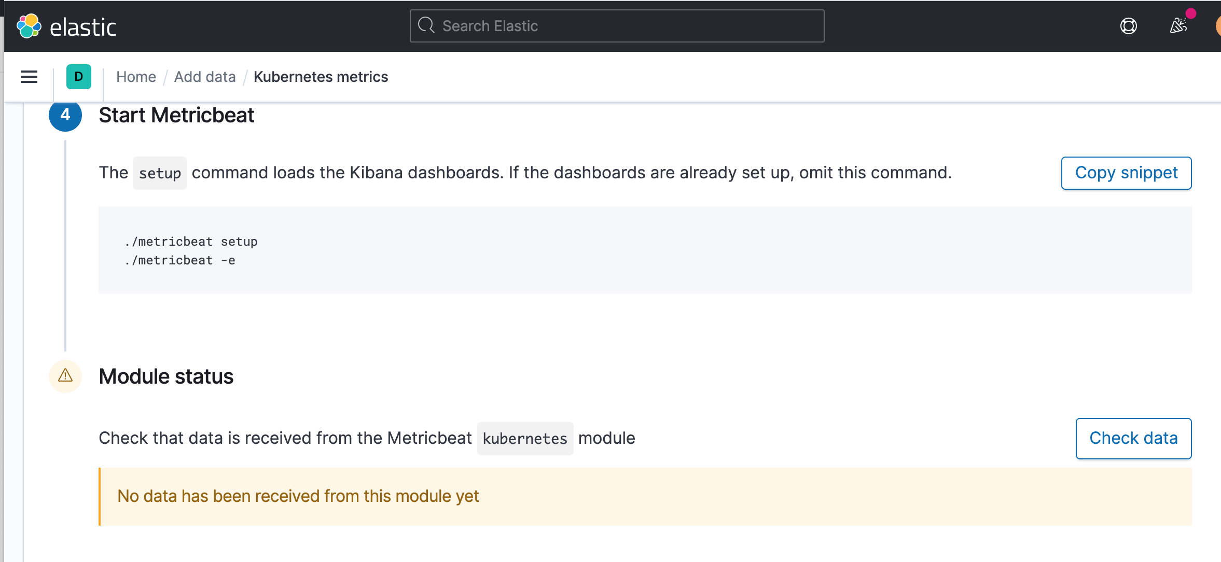
Challenges:
No chance to get kubernetes monitoring working using ELK stack

Slide 26
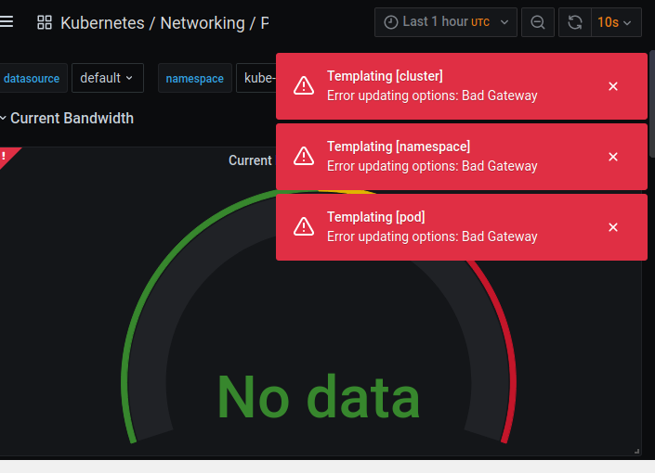
Challenges:
Spend some time troubleshooting this error received in kube Prometheus Grafana

Slide 27
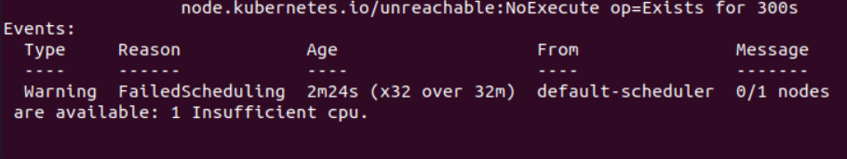
Some pods were in pending stating .
Describing the pods showed me the root reason of this error
Fix:
Added more CPU to my VM

Slide 28
Challenges:
Monitoring Alerts could not be set in ELK (license needed)
I couldn’t get alerts to run in kube prometheus

Slide 29
Resources:
https://github.com/Kari-sad/terraform-jenkins-docker-ansible-elk
https://gitlab.com/nanuchi/youtube-tutorial-series/-/blob/master/prometheus-exporter/install-prometheus-commands.md

Slide 30
Thanks for you attention

